Slide 1
AWS Academy Data Engineering
Notes:
|Slide number 1
|Instructor notes
|
|Student notes
Welcome to the AWS Academy Data Engineering course.

Slide 2
Data-Driven Organizations
AWS Academy Data Engineering
Notes:
|Slide number 2
|Instructor notes
|
|Student notes
Welcome to the Data-Driven Organizations module. This module introduces how modern organizations use data and data science to make decisions.

Slide 3
The data pipeline – infrastructure for data-driven decisions
Data-Driven Organizations
Notes:
|Slide number 3
|Instructor notes
|
|Student notes
A data pipeline provides the infrastructure to turn data into insights and make data-driven decisions. This section introduces the basic layers of a data pipeline.

Slide 4



A data pipeline in its simplest terms
The data pipeline is the infrastructure that you build to support data-driven decision-making.
At the most basic level, any data pipeline infrastructure must be able to (1) bring data in, (2) store it, and (3) provide the means to work with the data to derive insights.
As the data engineer or data scientist, it's your job to build the pipeline to figure out what's appropriate and how you're going to do it.
Often this will include exploring and experimenting to get to know the data and the best way to derive value from it.
Collect data
Store and process data
Build something useful with data
Notes:
|Slide number 4
|Instructor notes
|Modules 3 and 4 will iterate further on this topic. Those modules will apply more technical details about the types of data and data processing, and match that information to the AWS services and reference architectures that will be used. The goal of this section is to introduce the high-level vocabulary and provide a simplified analogy by using plastic building blocks. It might be helpful to return to this analogy as the course becomes more complex. Modules 6–11 will go deeper into each individual layer and the services and considerations that impact design of that layer.
|
|Student notes
The data pipeline is the infrastructure that you build to support data-driven decision-making. At the most basic level, any data pipeline infrastructure must be able to bring data in, store it, and provide the means to work with the data to derive insights. As the data engineer or data scientist, it's your job to build the pipeline to figure out what's appropriate and how you're going to do it. Often this will include exploring and experimenting to get to know the data and the best way to derive value from it.

Slide 5

Work backwards to design your infrastructure
The number of variations and options to create a data pipeline are broad.
The key to designing an effective decision-making infrastructure is to start with the business problem to be solved or decision to be made.
Then, build the pipeline that best suits that use case.
The cloud makes it easier to start up different infrastructure to serve different use cases.
An organization doesn't need to invest in an infrastructure that tries to serve all business needs with a single database, server, or technology stack.
For each use case, start with the end in mind, and build the data pipeline that supports it.
2. What data do you need to support this?
1. What decision are you trying to make?
Weigh the trade-offs of cost, speed, and accuracy.
Notes:
|Slide number 5
|Instructor notes
|
|Student notes
The number of variations and options to create a data pipeline are broad. The key to designing an effective decision-making infrastructure is to start with the business problem to be solved or decision to be made. Then, build the pipeline that best suits that use case. The cloud makes it easier to start up different infrastructure to serve different use cases. An organization doesn't need to invest in an infrastructure that tries to serve all business needs with a single database, server, or technology stack. For each use case, start with the end in mind, and build the data pipeline that supports it.

Slide 6




Layers of the pipeline infrastructure
The infrastructure layers that you need to build include methods to ingest and store data from the data sources that you have identified.
You need to make the stored data accessible for decision-making processes.
You must also create the infrastructure to process, analyze, and visualize data by using tools that are appropriate to the use case.
To build an appropriate infrastructure, you will need to understand the nature of the data and the intended type of processing and analysis to be performed.
Storage
Data sources
Predictions and decisions
Ingestion
Analysis & Visualization
Processing
Notes:
|Slide number 6
|Instructor notes
|
|Student notes
The infrastructure layers that you need to build include methods to ingest and store data from the data sources that you have identified. You need to make the stored data accessible for decision-making processes. You must also create the infrastructure to process, analyze, and visualize data by using tools that are appropriate to the use case. To build an appropriate infrastructure, you will need to understand the nature of the data and the intended type of processing and analysis to be performed.

Slide 7
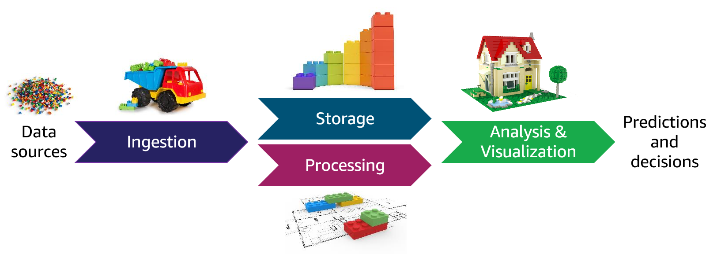
Actions taken with data in the pipeline
The pipeline must support the ability to discover details about the data and how it fits (or doesn't fit) your intended outcomes.
You might start with a hypothesis and use BI tools or other mechanisms to discover more information about the data, and then experiment and see where it takes you.
Data will almost always be transformed as it moves through the pipeline. This might include modifying the format to support a specific analysis tool or replacing values (for example, zeroes in place of nulls).
Data wrangling is a term that is used to describe the ways in which data is manipulated and transformed from its raw state into more meaningful states that downstream processes or users can use.
Data wrangling: Discover
Clean
Normalize
Enrich
Transformation
Notes:
|Slide number 7
|Instructor notes
|This slide includes an animation that runs automatically when you present the slide. It moves the data wrangling circle across the pipeline illustrating that data wrangling happens in multiple stages across the pipeline. |
|Student notes
Looking at the pipeline from the perspective of the data that travels through it, the pipeline must support the ability to discover details about the data and how it fits (or doesn't fit) your intended outcomes. You might start with a hypothesis and use BI tools or other mechanisms to discover more information about the data, and then experiment and see where it takes you.
Data might need to be cleaned or normalized. For example, you might merge multiple data sources that share some similar data and you need to rectify inconsistencies, or you might have a data source that hasn't been well-maintained or validated at its source. You need to prepare the data before it's viable for analysis.
Data will almost always be transformed as it moves through the pipeline. This might include modifying the format to support a specific analysis tool or replacing values (for example, zeroes in place of nulls). You might also augment the dataset by filling in gaps or enriching it with additional information. For example, you might calculate and save additional data values to be used during analysis. You might also add metadata to categorize and catalog data. Data wrangling is a term that is used to describe the ways in which data is manipulated and transformed from its raw state into more meaningful states that downstream processes or users can use.
Within each layer, or as part of transitioning between pipeline layers, you might perform these tasks on data to prepare it for the desired analysis or predictions. Some task types can happen in multiple places across the pipeline, and some tasks can be performed together as part of a single process. For example, in traditional data science architectures, the extract, transform, and load (ETL) process takes data from one source, performs some type of transformation on it, and then loads it into another location where the analysis is done.
As you learn about different scenarios, you will see these tasks performed at different points in the pipeline, using different services and methods dependent on the uses case.
The tools that you use and the way you perform these tasks will differ based on characteristics of your data, the business problem that you're addressing, and the methods or models that you're applying.

Slide 8
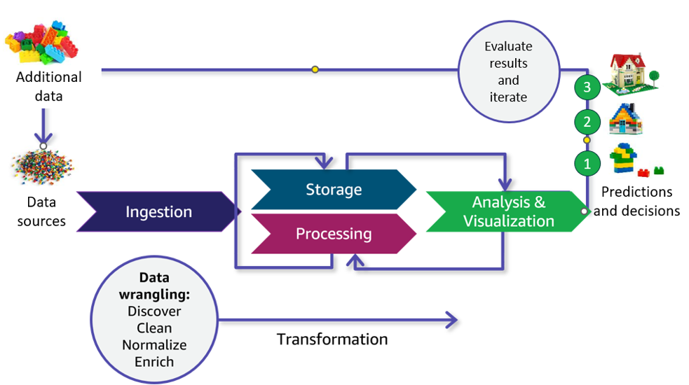
Iterative processing through the pipeline
Another key characteristic of deriving insights by using your data pipeline is that the process will almost always be iterative.
For example, in this illustration, the initial iteration (number 1) yielded a result that wasn't as defined as was desired. Therefore, the data scientist refined the model and reprocessed the data to get a better result (number 2).
After reviewing those results, they determined that additional data could improve the detail available in their result, so an additional data source was tapped and ingested through the pipeline to produce the desired result (number 3).
Notes:
|Slide number 8
|Instructor notes
|
|Student notes
Another key characteristic of deriving insights by using your data pipeline is that the process will almost always be iterative. You have a hypothesis about what you expect to find in the data, and you need to experiment and see where it takes you. You might develop your hypothesis by using BI tools to do initial discovery and analysis of data that has already been collected. You might iterate within a pipeline segment, or you might iterate across the entire pipeline. For example, in this illustration, the initial iteration (number 1) yielded a result that wasn't as defined as was desired. Therefore, the data scientist refined the model and reprocessed the data to get a better result (number 2). After reviewing those results, they determined that additional data could improve the detail available in their result, so an additional data source was tapped and ingested through the pipeline to produce the desired result (number 3).
A pipeline often has iterations of storage and processing. For example, after the external data is ingested into pipeline storage, iterative processing transforms the data into different levels of refinement for different needs.

Slide 9





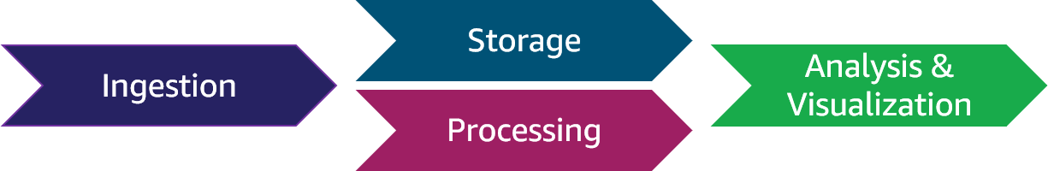
Example: A simple pipeline
S3 Select statements
Compressed .csv file
Amazon S3
Analyst
Developer
This example is similar to the pipeline that you will work with in the lab titled Accessing and Analyzing Data by Using Amazon S3.
The dataset to be ingested into the pipeline is a .csv file that contains structured data.
A developer uses a utility to compress the file, then uploads the file to an S3 bucket for storage.
The data science team who will analyze the data can use S3 Select statements to directly query the data in Amazon S3.
Notes:
|Slide number 9
|Instructor notes
|
|Student notes
This example is similar to the pipeline that you will work with in the lab titled Accessing and Analyzing Data by Using Amazon S3.
The dataset to be ingested into the pipeline is a .csv file that contains structured data. A developer uses a utility to compress the file, then uploads the file to an S3 bucket for storage. The data science team who will analyze the data can use S3 Select statements to directly query the data in Amazon S3.

Slide 10

Key takeaways: The data pipeline – infrastructure for data-driven decisions
A data pipeline provides the infrastructure for data-driven decision-making.
When designing a pipeline, start with the business problem to be solved and work backwards to the data.
The pipeline includes layers to ingest, store, process, and analyze and visualize data passing through it.
Data wrangling refers to how data is acted upon as it passes through the pipeline. Tasks include discovery, cleaning, normalization, transformation, and augmentation.
Data is processed iteratively to evaluate and improve upon results.
Notes:
|Slide number 10
|Instructor notes
|
|Student notes
Here are a few key points to summarize this section:
The data pipeline provides the infrastructure for data-driven decisions and includes layers to ingest, store, process, and analyze and visualize data.
Data wrangling refers to the work to transform data to prepare it for analysis. Processing is typically iterative. The business problem should drive the pipeline design.

Slide 11
The role of the data engineer in data-driven organizations
Data-Driven Organizations
Notes:
|Slide number 11
|Instructor notes
|
|Student notes
This section introduces the responsibilities of the data engineer and data scientist roles to plan and manage a data infrastructure.

Slide 12


Common data pipeline questions
Does the organization have the data that addresses the need? Where is the data stored and in what format?
Will I need to combine data from multiple sources?
What is the type and quality of data? What will be the source of truth?
What are the security requirements for this data? Who needs access to it and in what state?
What types of mechanisms are needed to transfer the data from its locations into the pipeline?
How much data is there, and how frequently is it updated or processed?
How important is speed when data is requested?
Data engineer
What can the data tell me?
How will I evaluate the results?
What kind of visualization do I need?
Which formats and tools are the analysts familiar with?
Do I need a big data framework?
Which type of AI/ML models fit?
What is the simplest way to implement AI/ML?
Data scientist
Notes:
|Slide number 12
|Instructor notes
|This slide is a baseline setup for activities that the student will perform throughout the course. You might withhold the questions and instead treat this as a precursor to the data module that follows. The slide is animated to support withholding the questions and treating this as a discussion.
|Ask students to think of the type of questions that they believe will need to be answered by the data engineer based on what they have learned so far.
|
|Student notes
To build the correct pipeline, the person responsible for building the pipeline needs to ask a lot of questions about the nature of the data and the intent for its processing. You can classify the questions broadly into data engineering questions, which are mostly focused on getting the data into the pipeline, and data science questions, which are mostly about what you are trying to get out of the data.
In the remainder of this course, you will learn how the answers to these types of data engineering questions lead you to select components and build pipelines that provide the appropriate infrastructure for data-driven decisions.

Slide 13
Key takeaways: The role of the data engineer in data-driven organizations
Both data scientist roles and data engineering roles work with the data pipeline, and tasks might be performed by someone in either role.
Data engineering is primarily focused on the infrastructure that the data passes through while the data scientist works with the data in the pipeline.
To build the right pipeline, you need to ask questions about the desired outcomes and the data and then iterate on your answers as you learn more.
Notes:
|Slide number 13
|Instructor notes
|
|Student notes
Here are a few key points to summarize this section:
Data scientists and data engineers both work with the data pipeline, and depending on your organization some tasks might be performed by either role. But generally speaking, the data engineer is focused on the infrastructure the data passes through and the data scientist is focused on analyzing the data in the pipeline. Both roles need to ask questions about how they data meets their needs, and iterate on their answers and design as they learn more.

Slide 14
Modern data strategies
Data-Driven Organizations
Notes:
|Slide number 14
|Instructor notes
|
|Student notes
This section introduces strategies that an organization can use to make the most of its data infrastructure.

Slide 15



Three-pronged strategy to build data infrastructure
Modernize
Unify
Innovate
If you go to work for an organization that aspires to use its data as a strategic asset, you will likely spend time helping the organization to adapt more traditional infrastructures toward those that are designed to better support data analytics and AI/ML.
Amazon Web Services (AWS) advises its customers to approach this type of data infrastructure along three strategies: modernize, unify, and innovate.
Notes:
|Slide number 15
|Instructor notes
|
|Student notes
If you go to work for an organization that aspires to use its data as a strategic asset, you will likely spend time helping the organization to adapt more traditional infrastructures toward those that are designed to better support data analytics and AI/ML. Amazon Web Services (AWS) advises its customers to approach this type of data infrastructure along three strategies: modernize, unify, and innovate.

Slide 16
Modernize
Increase agility and reduce undifferentiated lifting
Modernizing the infrastructure gives an organization the agility it needs to respond quickly to changes in the business landscape and incorporate new features.
AWS use the term undifferentiated heavy lifting to refer to the IT tasks that don't really help a business focus on their core value to customers, but take a lot of their time and resources. For example, managing data centers and hardware, or patching operating systems and databases.
By migrating applications and databases to the cloud, an organization can reduce its focus on administrative activities and instead focus development resources on business functionality.
The cloud also makes it easier to start up different infrastructure to serve different use cases.
They can also experiment with new environment types or services without committing to resources long term.
Another advantage of using cloud services is the ability to use purpose-built data stores rather than trying to use a single type of database to serve all needs. Choose a data store that matches the data structure and scalability that are required for each use case.
Together with purpose-built data stores, use loosely coupled components so that you can use services that are designed for a targeted purpose and modify or scale them independently from each other. This greatly increases the flexibility of the infrastructure.
Notes:
|Slide number 16
|Instructor notes
|
|Student notes
Modernizing the infrastructure gives an organization the agility it needs to respond quickly to changes in the business landscape and incorporate new features. The practices listed here are actually applicable to any modern application architecture, but in this course, you will look at them through the lens of data analytics and AI/ML use cases.
AWS use the term undifferentiated heavy lifting to refer to the IT tasks that don't really help a business focus on their core value to customers, but take a lot of their time and resources. For example, managing data centers and hardware, or patching operating systems and databases. By migrating applications and databases to the cloud, an organization can reduce its focus on administrative activities and instead focus development resources on business functionality. The cloud also makes it easier to start up different infrastructure to serve different use cases. An organization can choose the best set of tools and resources for each business problem. They can also experiment with new environment types or services without committing to resources long term.
Another advantage of using cloud services is the ability to use purpose-built data stores rather than trying to use a single type of database to serve all needs. Choose a data store that matches the data structure and scalability that are required for each use case. Together with purpose-built data stores, use loosely coupled components so that you can use services that are designed for a targeted purpose and modify or scale them independently from each other. This greatly increases the flexibility of the infrastructure.

Slide 17
Unify
Create a single source of truth
Break down data silos, unify data to create a single source of truth.
Democratize access, less depending on IT staff.
Equip users with tools to visualize their own insights.
Use a data lake and run queries directly on data.
Support simplified governance and movement between the data lake and purpose-built stores.
Notes:
|Slide number 17
|Instructor notes
|
|Student notes
One of the most important and most challenging strategies for successful data-driven organizations is to unify data to create a single source of truth. This means moving from siloed databases that one group of users access to a data lake, which brings all the data together and democratizes access. Control of data moves away from a centralized team such as IT, where users must request data. With modern data strategies, users can directly access the data that is relevant to them and build their own visualizations. Users can run queries directly against the data in the lake, but your infrastructure should also support movement between the data lake and purpose-built data stores that are needed for specific use cases.
Moving to this type of data structure often requires significant changes to the cultural aspects of who owns the data and the governance needed to maintain the single source of truth.

Slide 18
Innovate
Use AI and ML to discover new insights faster
Incorporate AI/ML into decision-making, and tap into new insights in vast amounts of unstructured data. Move from reactive to proactive decision-making.
The exploding availability of data and the lower costs of applying AI make it possible to incorporate AI and ML into more decision-making. Organizations that take advantage of this can drive value in new ways and adapt to changing business needs more proactively.
Take advantage of cloud services with AI/ML features that democratize who can use ML.
One trend in AWS service features is an increasing ability to apply an AI/ML type of functionality, without as much overhead or required experience as more traditional ML infrastructures. For example, Amazon SageMaker Studio provides fully managed ML infrastructure and a no-code visual interface for business analysts. Amazon Redshift is a data warehouse service, and one of its features, Redshift ML, helps users to create, train, and deploy SageMaker models by using familiar SQL syntax.
Notes:
|Slide number 18
|Instructor notes
|
|Student notes
As noted in an earlier section, the exploding availability of data and the lower costs of applying AI make it possible to incorporate AI and ML into more decision-making. Organizations that take advantage of this can drive value in new ways and adapt to changing business needs more proactively. But it takes conscious effort to reframe business problems as prediction problems and experiment with ML models.
One trend in AWS service features is an increasing ability to apply an AI/ML type of functionality, without as much overhead or required experience as more traditional ML infrastructures. For example, Amazon SageMaker Studio provides fully managed ML infrastructure and a no-code visual interface for business analysts. Amazon Redshift is a data warehouse service, and one of its features, Redshift ML, helps users to create, train, and deploy SageMaker models by using familiar SQL syntax.

Slide 19
"Being a data-driven organization means culturally treating data as a strategic asset and then building capabilities to put that asset to use – not just for big decisions but also for everyday action on the front line."
Ishit Vachhrajani, AWS Enterprise Strategist
Notes:
|Slide number 19
|Instructor notes
|
|Student notes
Organizations that can put their data to work to make better, more informed decisions, can respond faster to the unexpected and uncover completely new opportunities. To be successful, organizations need to treat data as a strategic asset and build an infrastructure that allows them to use that strategic asset for big and small decisions all across the organization.

Slide 20

Key takeaways: Modern data strategies
Organizations that want to become data driven should modernize, unify, and innovate with their data infrastructures.
Modernizing is about moving to cloud-based infrastructures and purpose-built services to reduce administrative and operational effort.
Unifying is about creating a single source of truth for data and making the data available across the organization.
Innovating is about looking for new ways to find value in the data—specifically, applying AI and ML to find new insights.
Notes:
|Slide number 20
|Instructor notes
|
|Student notes
Here are a few key points to summarize this section:
Organizations that want to become data driven should modernize, unify, and innovate. This means moving to cloud-based, purpose-built services and reducing operational overhead. It also means creating a single source of truth for data and making data available across the organization.
Organizations should innovate by finding new value in their data with the use of AI and ML.

Slide 21
Module wrap-up
Data-Driven Organizations
Notes:
|Slide number 21
|Instructor notes
|
|Student notes
This section summarizes what you have learned and brings the Data-Driven Organizations module to a close.

Slide 22
Module summary
This module prepared you to do the following:
Compare and contrast how data analytics and AI/ML are applied to data-driven decision-making.
Name and describe each layer in a data pipeline.
List ways in which data is acted upon as it passes through a pipeline.
List responsibilities for data engineer roles and data scientist roles in processing data through a pipeline.
Define three modern data strategies that influence how you build your data infrastructure.
Notes:
|Slide number 22
|Instructor notes
|This is a good opportunity to use an online group or discussion board to ask students to reflect on what they have learned. You might ask the students to recall a point from the module that aligns to one of the listed objectives. This provides a good segue to the knowledge check and sample exam question.
|
|Student notes
This module introduced data-driven decision-making and how data analytics and AI/ML can support decision-making. You learned that both data analytics and AI/ML can help with predictions, but AI/ML does it by learning about the data rather than by using programmed rules. You learned about the four main layers in a data pipeline: ingestion, storage, processing, and analysis and visualization. You were also introduced to the type of actions that are taken on data as it passes through the pipeline; for example, cleaning and transformation. You heard about the types of concerns that a data engineer or data scientist might have when building out and using a data pipeline. And finally, you learned about the modernize, unify, and innovate approach for building modern data infrastructures.

Slide 23

Module knowledge check
The knowledge check is delivered online within your course.
The knowledge check includes 10 questions that are based on material from the slides and slide notes.
You can retake the knowledge check as many times as you would like.
Notes:
|Slide number 23
|Instructor notes
|
|Student notes
Use your online course to access the knowledge check for this module.

Slide 24
Sample exam question
A traditional retailer with a relatively small online presence recently decided that they need to expand their online presence to increase sales. After a major marketing push and investing in IT infrastructure to support increased online transactions, quarterly results show that online sales results are far below expectations. The business wants to find ways to improve the poor online sales performance.
Which action represents an appropriate first step to address the request in a data-driven way?
Identify the key words and phrases before continuing.
The following are the key words and phrases:
Improve online sales
Appropriate first step
Data-driven way
Notes:
|Slide number 24
|Instructor notes: The key words section is animated to be revealed on click.
|
|Student notes
The question implies the need for some type of analytics solution, based on the desired outcome of improved sales and the desire to address the request in a data-driven way. The other key consideration is that the question asks for the first step.

Slide 25
Sample exam question: Response choices
A traditional retailer with a relatively small online presence recently decided that they need to expand their online presence to increase sales. After a major marketing push and investing in IT infrastructure to support increased online transactions, quarterly results show that online sales results are far below expectations. The business wants to find ways to improve the poor online sales performance.
Which action represents an appropriate first step to address the request in a data-driven way?
Choice
Response
A
Develop an ML model that analyzes customer comments to determine where customers are unsatisfied.
B
Use A/B testing to provide some customers with a new UI that is designed to simplify the purchasing process. Then, compare sales results from the old and new UIs.
C
Use a business intelligence (BI) tool to analyze sales data for the previous two quarters. Then, generate a hypothesis as to why the online sales are not in line with expectations.
D
Analyze the total revenue per customer, and create customer segments that receive different types of offers based on their segment.
Notes:
|Slide number 25
|Instructor notes
|
|Student notes
Use the key words that you identified on the previous slide, and review each of the possible responses to determine which one best addresses the question.

Slide 26
Sample exam question: Answer
The correct answer is C.
Choice
Response
C
Use a business intelligence (BI) tool to analyze sales data for the previous two quarters. Then, generate a hypothesis as to why the online sales are not in line with expectations.
Notes:
|Slide number 26
|Instructor notes
|
|Student notes
Choice A (Develop an ML model that analyzes customer comments to determine where customers are unsatisfied) might be appropriate if the retailer believes that the cause of poor sales is related to customer satisfaction with their products and services.
Choice B (Use A/B testing to provide some customers with a new UI that is designed to simplify the purchasing process, and then compare sales results from the old and new UIs) might be appropriate if the retailer believes that sales are low because customers are having difficulty making purchases through the older UI.
Choice D (Analyze the total revenue per customer, and create customer segments that receive different types of offers based on their segment) might be appropriate if the retailer believes that low sales can be attributed to the way that different customer segments shop on their website.
Each of these answers (A, B, and D) represents ways that the organization might gather and analyze additional data depending on their hypothesis. But the first step should be to work backwards from the business problem (poor sales) to form a hypothesis and then build a data pipeline to collect and process data iteratively. So choice C is the correct answer.

Slide 27
Ingesting Data by Batch or Stream

Slide 28
Ingesting by Batch or Stream
Objective: Understand how to design, build, and scale data ingestion pipelines using AWS services.
You will learn to:
Identify the tasks involved in building an ingestion layer.
Compare batch and stream ingestion strategies.
Understand AWS Glue for batch ingestion.
Learn about Amazon Kinesis for stream ingestion.
Explore ingestion for IoT data using AWS IoT Core and AWS IoT Analytics.
Address performance and scaling considerations in ingestion pipelines.

Slide 29
Comparing Batch and Stream Ingestion
Batch Ingestion:
Collects and processes data in fixed-size datasets.
Triggered on demand, by schedule, or events.
Ideal for periodic reporting and aggregated analytics.
Streaming Ingestion:
Continuously collects data in near real-time.
Processes data immediately upon arrival.
Suitable for real-time dashboards, recommendations, and alerts.
Key Decision Factors:
Volume: Total amount of data to ingest.
Velocity: Frequency at which data arrives.
Use Case Examples:
Batch: Retail sales aggregated daily.
Stream: Website clickstream analysis.

Slide 30
Batch Ingestion Pipeline – Tasks and Considerations
Common Steps:
Extract: Read from source systems.
Transform/Load: Clean and modify data.
Load/Transform: Load into target system and transform in place.
Design Requirements:
Ease of Use: Low-code or no-code tools; serverless options.
Scalability: Ability to handle large, diverse data volumes.
Monitoring: Workflow orchestration, logging, alerting.
Cost Optimization: Pay-as-you-go models and auto-scaling.

Slide 31
Purpose-Built AWS Tools for Batch Ingestion
Tool | Best For | Example Use Case
Amazon AppFlow | SaaS data integration | Ingesting support tickets from Zendesk
AWS DMS | Relational database migration | Oracle to Amazon Redshift data migration
AWS DataSync | File system data transfer | Genome files to Amazon S3
AWS Data Exchange | Ingesting third-party datasets | Clinical health data from data providers

Slide 32
AWS Glue – Simplifying Batch Ingestion
What it Offers:
Schema Detection: Crawlers infer schema from raw data.
Central Catalog: AWS Glue Data Catalog stores metadata.
Job Authoring: Visual ETL development with Glue Studio.
Serverless ETL: Spark-based jobs without managing servers.
Orchestration: Workflows with triggers, dependencies, retries.
Monitoring: CloudWatch insights, Spark UI, job logs.

Slide 33
Scaling Batch Processing with AWS Glue
Performance Goals:
Complete within time limits, stay within budget, and reduce failures.
Scaling Options:
Horizontal Scaling: Add more Glue workers. Best for large datasets.
Vertical Scaling: Use more powerful workers. Ideal for memory-heavy tasks.
Optimization Tip:
Use fewer large files (splittable) over many small files to reduce overhead.

Slide 34
Streaming Ingestion with Kinesis
Tasks in a Streaming Pipeline:
Extract: Producers push events to stream.
Transform/Load: Consumers process and store data.
Design Features:
High Throughput: Handle large-scale, fast-moving data.
Loose Coupling: Producers and consumers work independently.
Parallelism: Multiple consumers can process the same stream.
Fault Tolerance: Replay events and checkpoint processing progress.

Slide 35
Purpose-Built Kinesis Services
Service | Role in Pipeline
Kinesis Data Streams | Store and transport data in real-time shards
Kinesis Firehose | Apply transformations and load into storage (e.g., S3)
Kinesis Data Analytics | Run SQL/Java/Python/Scala analytics in real time
Integration: Ingests from IoT devices, web sources, apps, or other AWS services.

Slide 36
Scaling Stream Processing
Key Configurations:
Retention: Define how long data stays on stream.
Write Capacity: Set throughput for producers.
Read Capacity: Optimize for consumer performance.
Monitoring Tools:
CloudWatch: Track latency, failures, throttling.
CloudTrail: Audit configuration changes and data access.

Slide 37
IoT Data Ingestion – AWS Services
AWS IoT Core:
Connect, authenticate, and route data from IoT devices.
Supports MQTT protocol and publish/subscribe model.
Routes data via rules engine to S3, Kinesis, Lambda, etc.
AWS IoT Analytics:
Ingests unstructured IoT data.
Transforms and stores time-series data.
Enables visualization and analysis.
Architecture Tip: Use IoT Core for ingestion, and IoT Analytics for transformation and storage.

Slide 38
Storing and Organizing Data

Slide 39
Storing and Organizing Data
Objective: Learn how to select, use, and secure cloud-based storage solutions in a modern data architecture.
By the end of this module, you will be able to:
Define key storage types used in cloud data architectures.
Differentiate between data lakes, data warehouses, and purpose-built databases.
Match storage types with data processing needs.
Implement security best practices for cloud-based storage.

Slide 40
Types of Storage in Cloud Data Architectures
Block Storage:
Provides low-latency, high-performance storage blocks.
Suitable for databases and boot volumes.
Example: Amazon Elastic Block Store (EBS).
File Storage:
Organizes data in a hierarchical file system.
Ideal for shared access to media, content, and backups.
Example: Amazon Elastic File System (EFS).
Object Storage:
Stores data as individual objects with metadata and unique identifiers.
Supports massive scalability and cost efficiency.
Example: Amazon Simple Storage Service (S3).

Slide 41
Understanding the Storage Layer
The storage layer is the foundation of any data pipeline.
It integrates natively with AWS services and enables scalable storage for various data types.
Choosing the right storage type ensures performance, cost-effectiveness, and reliability.

Slide 42
Data Lake Storage
What is a Data Lake?
A centralized repository for storing structured, semi-structured, and unstructured data.
Allows you to store data in its raw form without requiring a predefined schema.
Built using Amazon S3 as the foundational storage layer.
Core Features:
Unlimited scale and low-cost storage.
In-place querying using services like Athena or Redshift Spectrum.
Integration with analytics and ML tools.
Secure data access using Lake Formation.

Slide 43
Amazon S3 – Data Lake Backbone
Highly durable, cost-effective, and secure.
Offers storage classes (e.g., Standard, Glacier) for cost optimization based on access frequency.
Supports multipart uploads and strong consistency.
Can serve as both active storage and archival.
Amazon Lake Formation:
Simplifies creation and management of secure data lakes.
Adds support for ACID transactions using governed tables.
Extends IAM with fine-grained access control.

Slide 44
Data Warehouse Storage
What is a Data Warehouse?
A centralized system for storing structured and semi-structured data optimized for analytics.
Separates storage from transactional systems to focus on querying and reporting.
Amazon Redshift:
Fully managed, cloud-native data warehouse.
Uses columnar storage for high-speed queries.
Supports Redshift Spectrum to query S3 data directly.

Slide 45
Data Lakes vs. Data Warehouses
Feature | Data Lake (S3) | Data Warehouse (Redshift)
Data Type | Structured, semi-structured, unstructured | Structured, semi-structured
Schema | Schema-on-read | Schema-on-write
Storage Cost | Lower | Higher
Use Case | ML, raw data, flexible exploration | BI, dashboards, structured analytics
Query Engines | Athena, EMR, Redshift Spectrum | Redshift

Slide 46
Purpose-Built Databases
Choosing a Purpose-Built Database Depends on:
Application Workload: OLTP, caching, analytics, etc.
Data Shape: Tabular, document, graph, key-value, etc.
Performance Requirements: Query latency, data volume.
Operations Burden: Backup, scaling, recovery, failover.
Examples of AWS Purpose-Built Databases:
RDS: Relational data (MySQL, PostgreSQL, etc.)
DynamoDB: NoSQL key-value and document.
Aurora: High-performance relational DB.
Neptune: Graph databases.

Slide 47
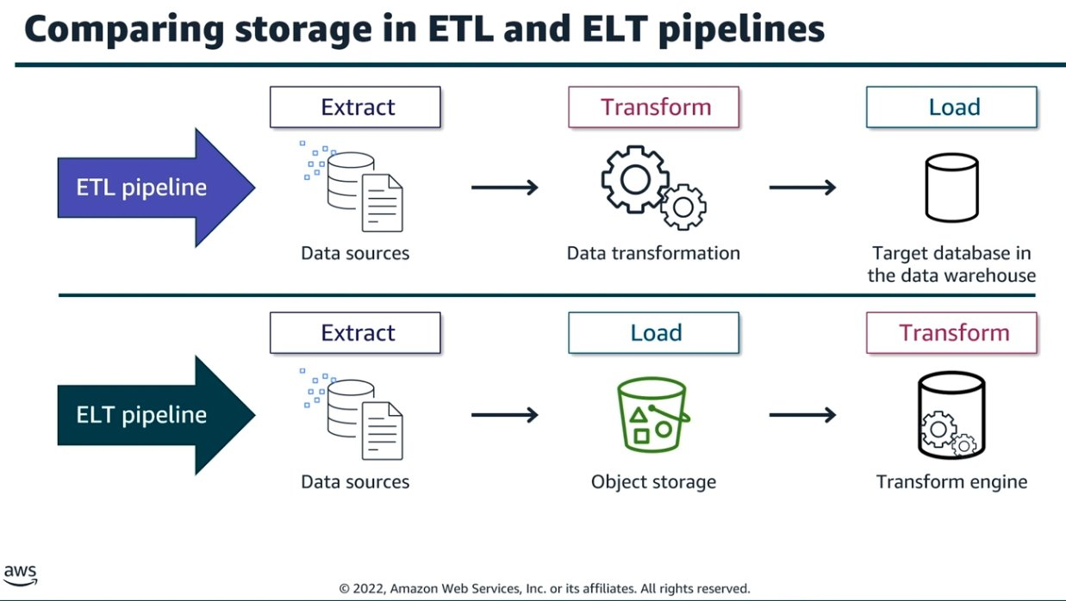
Storage in Support of ETL vs. ELT Pipelines
ETL (Extract, Transform, Load):
Data is transformed before being stored.
Typically uses intermediate storage during processing.
ELT (Extract, Load, Transform):
Data is loaded into the storage first.
Transformation is done after storage, enabling full flexibility and reusability.
Storage Types in Pipelines:
ETL: Uses temp storage and targets like S3 or Redshift.
ELT: Loads raw data directly into S3 or Redshift and transforms it using SQL or Glue.

Slide 48
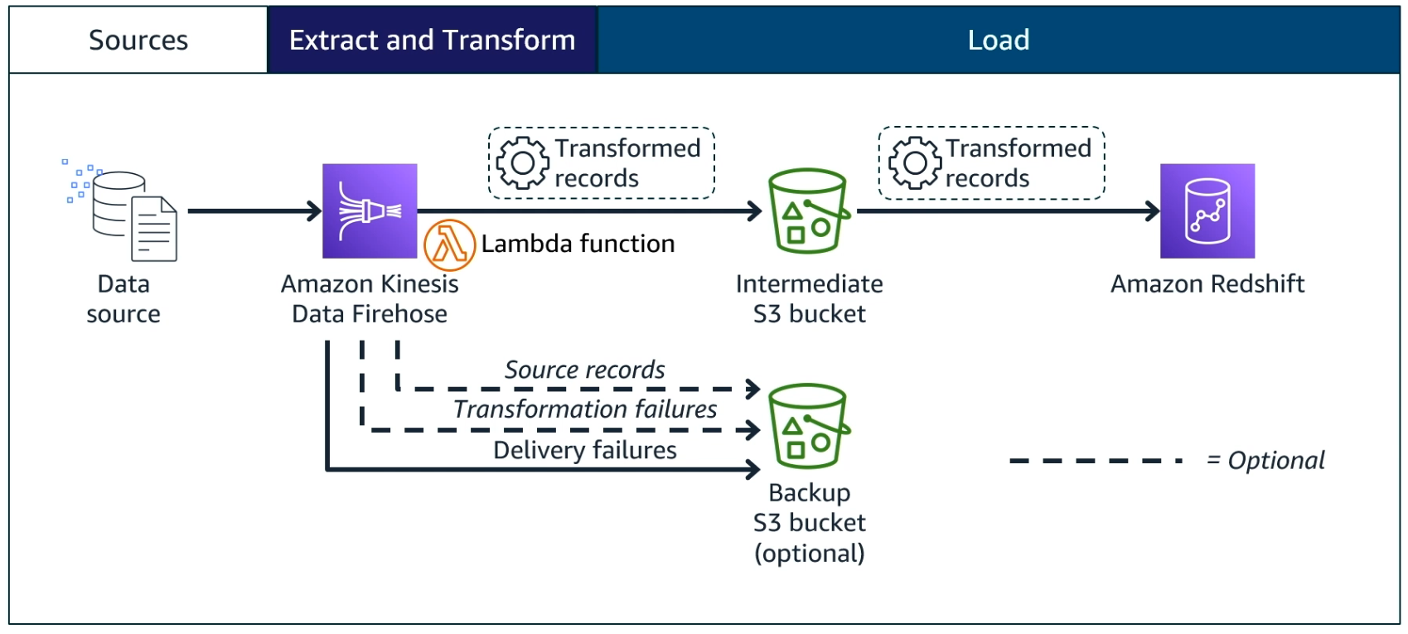
Example: Storage in support of an ETL pipeline
Kinesis is an ETL service by AWS

Slide 49
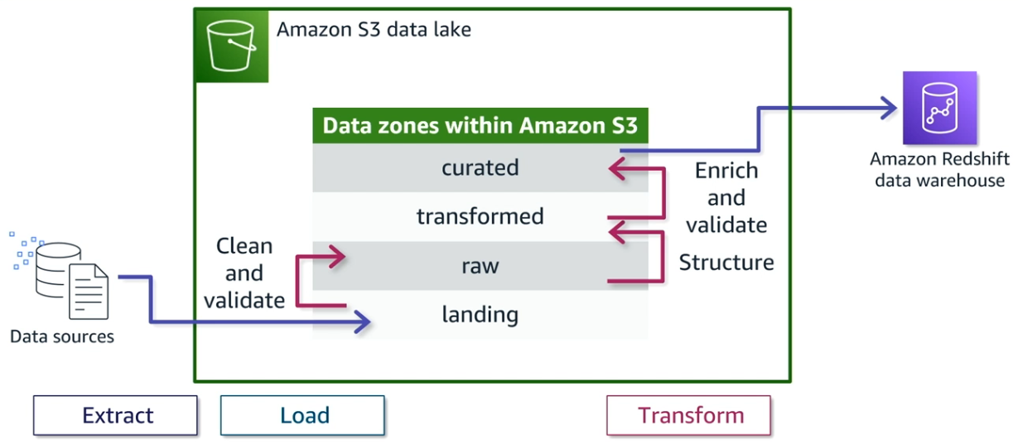
Example: Storage in support of an ELT pipeline

Slide 50
Securing Cloud Storage
Amazon S3 Security Features:
Resource-based and user IAM policies.
Encryption options: SSE-S3, SSE-KMS, client-side encryption.
Fine-grained access using S3 Access Points and tags.
Governed access via Lake Formation.
Amazon Redshift Security:
Handles service-level and database-level security separately.
Integrates with CloudWatch, CloudTrail, and Security Hub for auditing.
Supports compliance and governance requirements for regulated workloads.

Slide 51
File Formats
Format | Description
Apache Avro | A row-based data serialization framework developed within the Apache Hadoop project. Avro uses JSON to define schemas and supports schema evolution.
JSON | A lightweight, text-based data interchange format that's easy for humans to read and write, and easy for machines to parse and generate.
Apache Parquet | A columnar storage file format optimized for use with big data processing frameworks like Apache Spark and Hive. Offers efficient data compression.
Optimized Row Columnar (ORC) | A columnar storage format primarily used with the Apache Hive ecosystem. ORC provides high compression and fast performance for reading large datasets.

Slide 52
Processing Big Data

Slide 53
Processing Big Data
Objective: Learn to select, configure, and operate big data processing frameworks using AWS tools.
By the end of this module, you will be able to:
Compare batch vs. streaming big data processing.
Understand Apache Hadoop and Apache Spark.
Deploy and manage Amazon EMR clusters.
Use Apache Hudi for near real-time data updates.

Slide 54
Big Data Processing Concepts
Types of Processing:
Batch Processing:
Handles large volumes of historical (cold) data.
Processes data in scheduled intervals or batches.
Suitable for deep, complex analysis.
Tools: Amazon EMR, Hadoop, Spark (batch mode).
Streaming Processing:
Ingests and processes real-time (hot) data as it arrives.
Handles continuous, unpredictable data flows.
Supports low-latency analytics and event-driven systems.
Tools: Apache Spark Streaming, Amazon Kinesis.

Slide 55
Apache Hadoop Overview
What is Hadoop?
An open-source distributed framework for storage and processing.
Executes jobs across clusters of servers.
Core Components:
HDFS (Hadoop Distributed File System): Stores data in blocks with replication.
YARN: Allocates cluster resources and manages job execution.
MapReduce: Splits jobs into map and reduce tasks for parallel execution.
Hadoop is best for:
Handling massive datasets with high fault tolerance.
Traditional batch analytics workloads.

Slide 56
Hadoop Ecosystem Tools
Apache Hive: SQL-like queries on large datasets without writing MapReduce code.
Apache Pig: Data flow scripting for parallel execution.
Apache Flink: Optimized for both stream and batch processing.
Presto: Fast, in-memory query engine ideal for interactive queries.

Slide 57
Apache Spark Overview
What is Spark?
A distributed data processing framework with in-memory computation.
Optimized for speed, supports iterative ML and interactive analytics.
Spark Architecture:
Driver Program: Manages the overall job.
Executors: Execute tasks and store data in memory for reuse.
SparkContext & Cluster Manager: Coordinate resources and tasks.
Spark Components:
Spark Core, Spark SQL, Spark MLlib (ML), Spark Streaming, GraphX.

Slide 58
Amazon EMR – Managed Hadoop and Spark
Amazon EMR (Elastic MapReduce):
AWS-managed service to run open-source tools like Hadoop, Spark, Hive, and Hudi.
Supports petabyte-scale data processing.
Use Cases:
ETL, machine learning, interactive analytics, and log processing.
Node Types:
Main Node: Controls cluster and manages tasks.
Core Nodes: Store data in HDFS and run tasks.
Task Nodes: Execute tasks only.

Slide 59
EMR Cluster Setup and Management
Ways to Launch Clusters:
Interactive Mode (AWS Console)
Command Line Interface (CLI)
APIs (Automation)
Cluster Types:
Long-Running Clusters: Persistent jobs and state.
Transient Clusters: Temporary, shut down after processing.
Scaling EMR:
Manual Scaling
EMR Managed Scaling
Custom Auto-Scaling Policies

Slide 60
Connecting to EMR Clusters
Connect via SSH to the main node using its public DNS.
Security groups must be configured for access.
Clusters must be running to allow any interaction.

Slide 61
Apache Hudi – Managing Dynamic Data
What is Apache Hudi?
A data management framework optimized for fast ingestion and updates.
Works well with Spark, Hive, and Presto.
Storage Modes:
Copy on Write (CoW): Writes entire files; ideal for frequent reads.
Merge on Read (MoR): Logs changes separately and merges during read.
Views:
Read-Optimized View: For quick reads.
Incremental View: Shows data changes.
Real-Time View: Combines base files and logs for up-to-date reads.

Slide 62
Real-Time Data Updating with Hudi
Hudi DeltaStreamer automates ingesting and updating datasets.
Maintains ACID transactions for concurrent data operations.
Enables schema evolution and data versioning in S3-based lakes.

Slide 63
Analyzing and Visualizing Data

Slide 64
Analyzing and Visualizing Data
Objective: Understand how to choose and apply AWS tools to analyze and visualize data effectively.
By the end of this module, you will be able to:
Identify factors that influence the choice of analysis and visualization tools.
Compare AWS services for data analysis and visualization.
Select the right tool based on business needs, data characteristics, and access requirements.

Slide 65
Factors That Influence Tool Selection
1. Business Needs:
What decisions must be supported by the analysis?
What types of insights or KPIs are required?
Do users need dashboards, reports, or both?
2. Data Characteristics:
What is the size (volume) and speed (velocity) of the data?
Is the data structured or unstructured?
How often is the data updated?
3. Access to Data:
Where is the data stored, and who needs access?
What access levels should be granted (read, write, analyze)?
Follow the principle of least privilege.

Slide 66
Business Needs – Types of Visualizations
Insight Type | Description | Examples
KPIs | Track performance | Revenue, retention rate
Relationships | Show variable interactions | User actions vs. outcomes
Comparisons | Examine differences over time or between groups | Monthly sales by region
Distributions | Display data spread | Error rates, response times
Compositions | Highlight parts of a whole | Sales by category

Slide 67
Data Characteristics – Examples
Data Type | Use Case
Historical data | Drill-down on yearly sales
Real-time (IoT) | Monitor live sensor error rates
Structured | Query customer support logs in RDS
Unstructured | Analyze email sentiment using NLP tools
Mixed sources | Aggregate sales, logs, and social data

Slide 68
Comparing AWS Tools and Services
Tool | Primary Use | Highlights
Amazon Athena | SQL queries on S3 data | Serverless, one-time queries, Apache Iceberg
Amazon QuickSight | Dashboards and BI reporting | Natural language queries with QuickSight Q
Amazon OpenSearch | Real-time log and telemetry analytics | Integrated with OpenSearch Dashboards

Slide 69
Amazon Athena
Interactive query service using SQL.
Works directly with data in Amazon S3.
Serverless—no infrastructure to manage.
Integrated with BI tools like QuickSight.
Supports data modification via Apache Iceberg (insert, update, delete, version control).

Slide 70
Amazon QuickSight
Scalable business intelligence (BI) service.
Connects to various data sources.
Provides interactive dashboards, KPIs, forecasts.
Features QuickSight Q: Use natural language to ask questions and get instant visual answers.
Example: “Show last year’s weekly sales in California.”

Slide 71
Amazon OpenSearch Service
Managed open-source search and analytics engine.
Ideal for log analytics, app monitoring, clickstream analysis.
Integrated with OpenSearch Dashboards (formerly Kibana).
Example Use Case:
Visualize customer call transcripts using S3 + Comprehend.
Use pie charts, bar charts, and histograms to track call sentiment and keyword trends.

Slide 72
Use Case – Gaming Analytics
Three Personas:
Analyst: Uses Athena to query player usage data.
Business User: Uses QuickSight to visualize revenue and retention KPIs.
DevOps Engineer: Uses OpenSearch to monitor server performance in real-time.
Key Tools in Use Case:
Athena: For daily aggregated data queries.
QuickSight: For high-level KPI dashboards.
OpenSearch: For live telemetry and log analysis.

Slide 73
Automating the Pipeline

Slide 74
Automating the Pipeline
Objective: Learn how to automate infrastructure and data workflows using DevOps principles and AWS Step Functions.
By the end of this module, you will be able to:
Identify the advantages of pipeline automation.
Understand the CI/CD process in data pipelines.
Describe the components and states of AWS Step Functions.
Build automated workflows using Step Functions and Athena.

Slide 75
Automating Infrastructure Deployment
Why automate?
Reduces manual effort, risk of human error, and downtime.
Ensures repeatable, consistent environment setup.
Infrastructure as Code (IaC):
Define infrastructure in scripts (JSON, YAML, or Terraform).
Benefits: Repeatability and Reusability.
Automatically recreate environments for testing, deployment, and disaster recovery.

Slide 76
CI/CD and DevOps
CI/CD (Continuous Integration / Continuous Delivery):
Part of the DevOps lifecycle, focused on rapid, reliable software delivery.
CI (Continuous Integration):
Developers regularly merge code into a shared repo.
Automated builds and tests validate changes.
CD (Continuous Delivery/Deployment):
Code changes automatically released to production.
Reduces risk and speeds up releases.
Benefits in Data Engineering:
Automates transformation pipelines.
Reduces delays in deploying analytics or ML updates.

Slide 77
Introduction to AWS Step Functions
What are Step Functions?
A fully managed workflow orchestration service.
Coordinates components of distributed apps and microservices using visual workflows.
Manages retries, logging, and state transitions automatically.
Key Uses:
Automate ETL, analytics workflows, and batch processing pipelines.
Integrate with Amazon Athena, Lambda, Glue, and more.

Slide 78
Step Functions Interface Overview
Canvas: Visual editor where you drag and drop states.
States Browser & Actions Panel: Predefined elements you can use.
Inspector: Displays auto-generated code (JSON/YAML) for each state.
Workflow = State Machine
Each step = State
Transitions define the order of operations
Code is auto-generated but fully customizable

Slide 79
Types of States in Step Functions
State Type | Purpose
Task | Executes work using services like Lambda
Pass | Transfers input to output, no computation
Choice | Branches workflow based on condition
Parallel | Executes multiple branches concurrently
Wait | Pauses workflow for a defined duration
Map | Iterates over items like a loop
Succeed | Marks workflow as successful
Fail | Marks workflow as failed with error

Slide 80
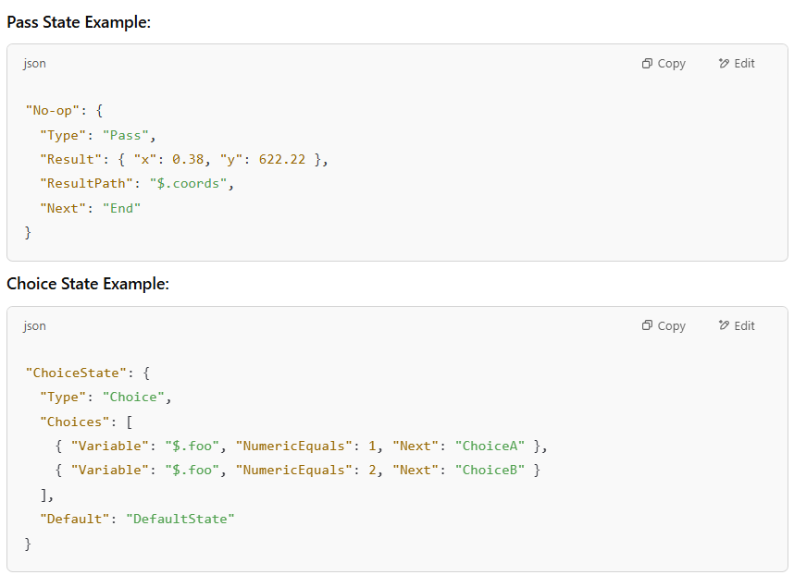
Code Examples – State Types

Slide 81
Simplifying ETL with Step Functions
Integrates seamlessly with Amazon Athena and AWS Glue.
Enables conditional branching to check if Glue tables exist.
Allows dynamic workflow creation based on dataset metadata.
Supports advanced formats like Parquet with Snappy compression to optimize storage and query performance.

Slide 82
Lab Summary – Orchestrating ETL with Step Functions
Lab Highlights:
Use Step Functions to coordinate Athena queries.
Build logic to check for existing tables and create them if needed.
Store transformed data in compressed Parquet format using Snappy.
Benefit: Reduces storage costs, improves query speed, and supports schema evolution.

